Slide 1







$$f\left(w\right)=w^{4}−2w$$
$$≠$$
$$𝒞=\left[a,b\right]$$
$$f′\left(w^{∗}\right)=0$$
$$\min_{w}{f\left(w\right)}$$
s.t. $w∈𝒞$
In the presence of constraints, the optimum may fail to be a stationary point of the objective
GD iterations may step outside the feasible set and violate constraints ☹

Slide 2
one does not simply descend into optimality
… unless one wishes to introduce a plot hole by summoning the Eagles

Slide 3
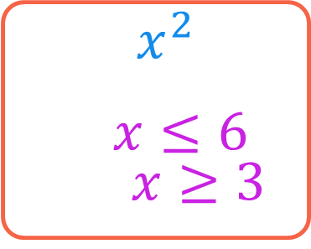

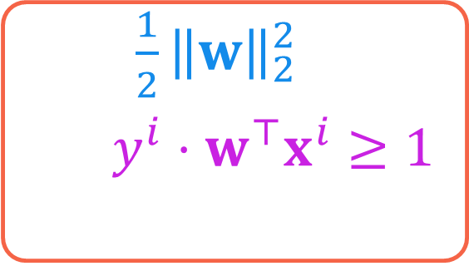
Constrained Optimization
Optimization problems have an objective, one or more constraints
Find me the real number with smallest squared value that is smaller than $6$ and larger than $3$
Find me the model with the least Euclidean norm that classifies all points correctly
The set of points satisfying all constraints is called the feasible set $𝒞$
$\min_{x}{x^{2}}$
s.t. $x≤6$ and $x≥3$
Objective
Constraints
Objective
$\min_{w}{\frac{1}{2}{\left\|w\right\|}_{2}^{2}}$
s.t. $y^{i}⋅w^{⊤}x^{i}≥1$ for all $i∈\left[n\right]$
Constraints

Slide 4









Projected Descent Methods
Wait … the projection step itself looks like an optimization problem!
This technique is useful only if $𝒞$ is such that projection step is easy
Technique 1 (Projections):
Undo violations done by GD
Trick: If after descent step, we violate a constraint, go back into the feasible set $𝒞$
Use a “projection step” $Π_{𝒞}\left(x\right)≝\arg{\min_{z∈𝒞}{{\left\|x−z\right\|}_{2}^{2}}}$
PROJECTED GRADIENT DESCENT (PGD)
Given: objective function $f:ℝ^{d}→ℝ$ and feasible set $𝒞⊂ℝ^{d}$
Initialize $w^{0}∈ℝ^{d}$
For $t=0, 1, …$
Get a (sub)gradient $g^{t}∈∂f\left(w^{t}\right)$
Choose a step length $η_{t}$
Update $u^{t+1}←w^{t}−η_{t}⋅g^{t}$
Project $w^{t+1}←Π_{𝒞}\left(u^{t+1}\right)$
Repeat until convergence
The projection step ensures we move as little as possible – this is to avoid undoing the objective value reduction we got out of the descent step
Projections are idempotent i.e., if $x∈𝒞$, then $Π_{𝒞}\left(x\right)=x$
We can easily modify this method to work with SGD, mini-batch SGD, CD, CM
$$𝒞$$

Slide 5





A few useful Projections
Finding the closest point in a set $Π_{𝒞}\left(x\right)=\arg{\min_{z∈𝒞}{{\left\|x−z\right\|}_{2}^{2}}}$
$$𝒞=\left\{z:{\left\|z\right\|}_{2}≤1\right\}$$
$$𝒞=\left\{z:z_{i}≥0\right\}$$
$$Π_{𝒞}\left(x\right)=\left\{\begin{matrix}\begin{matrix} x & if {\left\|x\right\|}_{2}≤1\end{matrix} \\ \begin{matrix}\frac{x}{{\left\|x\right\|}_{2}} & if {\left\|x\right\|}_{2}>1\end{matrix}\end{matrix}\right.$$
$$Π_{𝒞}\left(x\right)=z \\ z_{i}=\left\{\begin{matrix}\begin{matrix}x_{i} & if x_{i}≥0\end{matrix} \\ \begin{matrix}0 & if x_{i}<0\end{matrix}\end{matrix}\right.$$

Slide 6





A few useful Projections
Constraints of the form $x_{i}∈\left[a_{i},b_{i}\right]$ are often call box constraints since the feasible set looks like a box
Finding the closest point in a set $Π_{𝒞}\left(x\right)=\arg{\min_{z∈𝒞}{{\left\|x−z\right\|}_{2}^{2}}}$
$$𝒞=\left\{z:{\left\|z−c\right\|}_{2}≤r\right\}$$
$$𝒞=\left\{z:z_{i}∈\left[a_{i},b_{i}\right]\right\}$$
$$Π_{𝒞}\left(x\right)=\left\{\begin{matrix}\begin{matrix} x & if {\left\|x−c\right\|}_{2}≤r\end{matrix} \\ c+\begin{matrix}\frac{r⋅\left(x−c\right)}{{\left\|x−c\right\|}_{2}} & if {\left\|x−c\right\|}_{2}>r\end{matrix}\end{matrix}\right.$$
$$Π_{𝒞}\left(x\right)=z \\ z_{i}=\left\{\begin{matrix}\begin{matrix}x_{i} & if x_{i}∈\left[a_{i},b_{i}\right]\end{matrix} \\ \begin{matrix}a_{i} & if x_{i}<a_{i}\end{matrix} \\ \begin{matrix}b_{i} & if x_{i}>b_{i}\end{matrix}\end{matrix}\right.$$

Slide 7

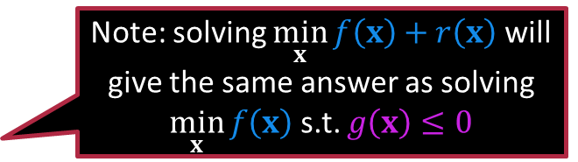

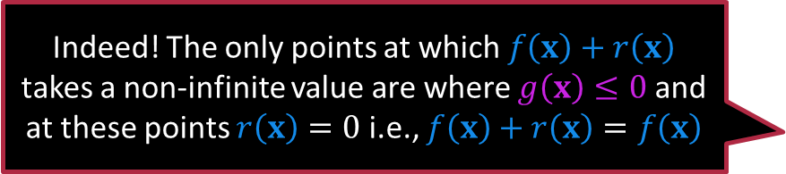
Get rid of Constraints
Technique 2 (Barrier Method):
Prevent constraint violation
Suppose we wish to solve
$\min_{x}{f\left(x\right)}+r\left(x\right)$ s.t. $g\left(x\right)≤0$
Trick: Use barrier functions to shift the constraint into the objective
Barrier Function: takes $∞$ value outside a permitted set $r\left(x\right)=\left\{\begin{matrix}\begin{matrix}0 & if g\left(x\right)≤0\end{matrix} \\ \begin{matrix}∞ & if g\left(x\right)>0\end{matrix}\end{matrix}\right.$
Note: solving $\min_{x}{f\left(x\right)+r\left(x\right)}$ will give the same answer as solving $\min_{x}{f\left(x\right)}$ s.t. $g\left(x\right)≤0$
Indeed! The only points at which $f\left(x\right)+r\left(x\right)$ takes a non-infinite value are where $g\left(x\right)≤0$ and at these points $r\left(x\right)=0$ i.e., $f\left(x\right)+r\left(x\right)=f\left(x\right)$

Slide 8


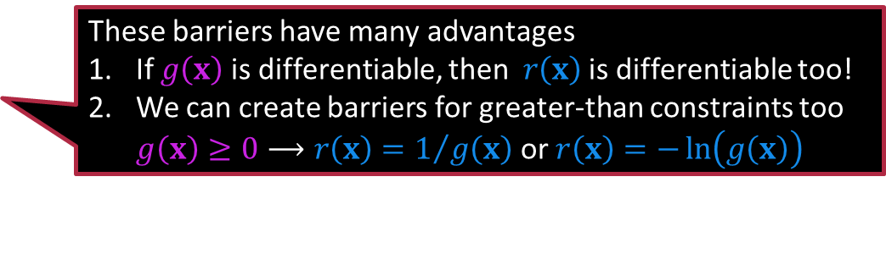




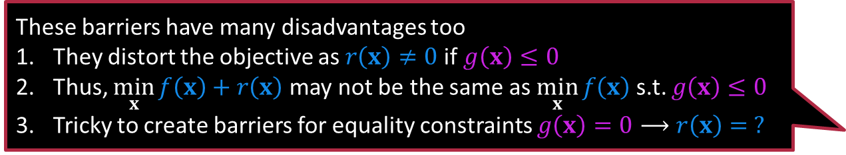

Approximate Barriers
Note that these barriers work only if the problem is a minimization problem.
Inverse barrier: $g\left(x\right)≤0⟶r\left(x\right)=\frac{1}{−g\left(x\right)}$
Logarithmic barrier: $g\left(x\right)≤0⟶r\left(x\right)=−\ln\left(−g\left(x\right)\right)$
$$r\left(x\right)$$
These barriers have many advantages
If $g\left(x\right)$is differentiable, then $r\left(x\right)$ is differentiable too!
We can create barriers for greater-than constraints too $g\left(x\right)≥0⟶r\left(x\right)=1/{g\left(x\right)}$ or $r\left(x\right)=−\ln\left(g\left(x\right)\right)$
$$g\left(x\right)$$
$$r\left(x\right)$$
These barriers have many disadvantages too
They distort the objective as $r\left(x\right)≠0$ if $g\left(x\right)≤0$
Thus, $\min_{x}{f\left(x\right)+r\left(x\right)}$ may not be the same as $\min_{x}{f\left(x\right)}$ s.t. $g\left(x\right)≤0$
Tricky to create barriers for equality constraints $g\left(x\right)=0⟶r\left(x\right)= ?$
$$g\left(x\right)$$

Slide 9







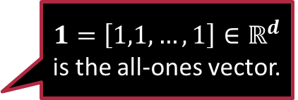


Illustrative Example
$1=\left[1,1,…,1\right]∈ℝ^{d}$ is the all-ones vector.
The solution is $x^{∗}=\left[\frac{1}{\sqrt{d}},\frac{1}{\sqrt{d}},…,\frac{1}{\sqrt{d}}\right]=\frac{1}{\sqrt{d}}⋅1$ Will the barrier method be able to discover it?
Consider the simple optimization problem $\max_{x∈ℝ^{d}}{−x^{⊤}1}$ s.t. ${\left\|x\right\|}_{2}^{2}≤1$
Step 1: Create a barrier function $r\left(x\right)≝−\ln\left(1−{\left\|x\right\|}_{2}^{2}\right)$
Step 2: Create the new problem with an augmented objective $\max_{x∈ℝ^{d}}{−x^{⊤}1−\ln\left(1−{\left\|x\right\|}_{2}^{2}\right)}$
Applying FOO gives us $2⋅x=\left(1−{\left\|x\right\|}_{2}^{2}\right)⋅1$ i.e., all coordinates same
Take norms on both sides gives us $2⋅{\left\|x\right\|}_{2}=\left(1−{\left\|x\right\|}_{2}^{2}\right)\sqrt{d}$
Solving the quadratic gives ${\left\|x\right\|}_{2}=\left({\left(\sqrt{d+1}−1\right)}/{\sqrt{d}} \right)$
The answer is $\hat{x}=c⋅1$ with $c=\frac{1}{\sqrt{d}}\left(\frac{\sqrt{d+1}−1}{\sqrt{d}}\right)$
Must convert the max problem to a min problem first or else there will be trouble
Can’t use a barrier that shoots up to $∞$ in a max problem
The answer is not optimal but notice that ${\left\|c⋅1\right\|}_{2}≤1$ i.e., the constraint is respected ☺. Also, $c→\frac{1}{\sqrt{d}}$ as $d→∞$

Slide 10







Illustrative Example – Improvements
Regularization constants are usually specified by us and are a type of hyperparameter. We will study them in detail later.
$$r\left(x\right)$$
$$λ=1$$
The barrier distortion can be controlled explicitly introducing a regularization constant $λ>0$ $\min_{x∈ℝ^{d}}{−x^{⊤}1−λ⋅\ln\left(1−{\left\|x\right\|}_{2}^{2}\right)}$
Applying FOO gives us $2λ⋅x=\left(1−{\left\|x\right\|}_{2}^{2}\right)⋅1$
Solving this gives ${\left\|x\right\|}_{2}=\left({\left(\sqrt{d+λ^{2}}−λ\right)}/{\sqrt{d}} \right)$
This gives $x=c⋅1$ where $c=\frac{1}{\sqrt{d}}\left(\frac{\sqrt{d+λ^{2}}−λ}{\sqrt{d}}\right)$
As $λ→0$, we get $\sqrt{d+λ^{2}}−λ→\sqrt{d}$ i.e., $c→\frac{1}{\sqrt{d}}$
$$g\left(x\right)$$
$$r\left(x\right)$$
$$λ=0.5$$
$$g\left(x\right)$$
$$r\left(x\right)$$
Why not just set $λ=0$? That would eliminate the distortion, right?
$$λ=0.1$$
Nope, that might give a wrong solution that violates the constraint! We need the barrier but also regulate its strength
$$g\left(x\right)$$

Slide 11
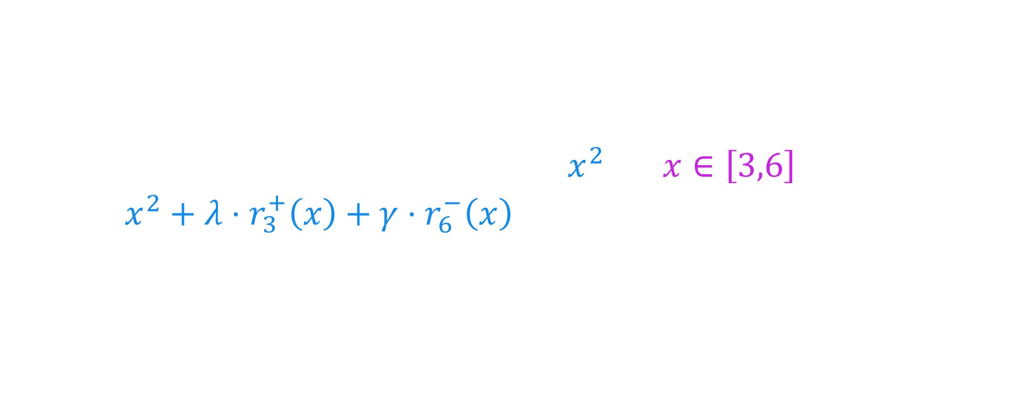
Exercise
For constants $p,q∈ℝ$, create logarithmic barrier functions
Create a barrier $r_{p}^{+}\left(x\right)$ for the constraint $x≥p$
Create a barrier $r_{q}^{−}\left(x\right)$ for the constraint $x≤q$
Solve the constrained problem $\min_{x}{x^{2}}$ s.t. $x∈\left[3,6\right]$ by solving $\min_{x}{x^{2}+λ⋅r_{3}^{+}\left(x\right)+γ⋅r_{6}^{−}\left(x\right)}$ ($λ,γ>0$ are regularization const.)
First, solve the problem using $λ=γ=1$? Is it the correct solution?
How does the solution change as $λ,γ→0$, say with $λ=γ=0.01$?
How about as $λ,γ→∞$, say with $λ=γ=10$?
Hint: to use FOO, you may need to use a cubic equation solver

Slide 12
Summary
Explored two ways to solve constrained optimization problems
Projected Descent methods
Require projection onto the feasible step after every iteration
Can be used with GD, SGD, MB-SGD, CD, CM etc ☺
Projection can be expensive making PGD unusable ☹
Barrier Optimization methods
Allows us to sneak constraints into the objective
Allow FOO or GD-style methods to be applied ☺
May distort the objective ☹ – regularization constants offer some relief 😐
Tricky to handle equality constraints ☹
Next discussion: exact barriers and the powerful method of duals

Slide 13
Have Fun!
See you next time.

